Slide 1
MICROPROCESSORS GROUP 20 PROJECT WORK HEART RATE AND TEMPERATURE MONITORING SYSTEM

Slide 2
GROUP MEMBERS
OMARU, Osman Shehu - 1858822
NYENKU, Frank Aidoo - 1857222
OBENG, Christopher - 1857322
OBOUBI, Emmanuel Yeboah - 1857522
OCANSAH, Odelia Ole Sena- 1857622
OCRAN, Oliver Amo Hanson - 1857722
ODAME, Ronald - 1857822
ODUM, Efua Nhyira Kwarley - 1857922
ODURO, Boateng Emmanuel - 1858122

Slide 3
TABLE OF CONTENTS
Problem Statement
Methodology
Demonstration/Simulation
Conclusion
Notes:
In today’s presentation, we will be discussing the problem of effectively checking health vitals such as heart rate and temperature of patients. We will also explain some approaches we came up with in order to solve the problem.

Slide 4
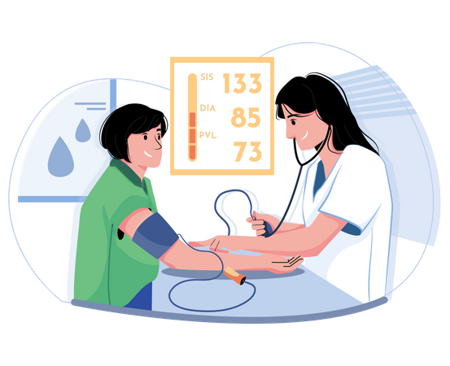
Problem statement
Advancements in Vital Monitoring: Traditional vital checks require hospital visits, specialized equipment, and professional interpretation, but technology is revolutionizing this process.
Traditional Vital Monitoring Methods: Early methods like touch-based fever checks, mercury thermometers, and manual pulse monitoring were useful but time-consuming, less accurate, and lacked continuous tracking.
Notes:
The healthcare field is undergoing one of the most remarkable technological evolutions in monitoring vitals. Traditionally, if you need to have your vitals, such as heart rate, temperature, blood pressure, and others checked, you will have to take a day off and spend the better part of the day at the hospital. These measurements are taken using specialized equipment and interpreted by a healthcare professional.
In earlier years, body temperature was checked either by feeling the forehead or neck with the back of the hand to check for fever or by placing a mercury thermometer under the tongue, or armpit. The heart rate, on the other hand, was monitored by either using fingers to feel the pulse on the wrist, checking the pulse on the neck (carotid artery), or listening to the heartbeat using a stethoscope. Although these methods were helpful, they were time-consuming i.e. they required more time compared to digital tools, they were less accurate, and they could not track vitals over time.
These and many others are reasons why technology has advanced. The impact of health vital monitoring evolution has empowered patients to at least gain basic insights into their health, encourage them to be aware of possible indicators of future distress, and also adopt healthier lifestyles.

Slide 5

methodology
To solve the problem of monitoring and displaying heart rate and body temperature the system must:
Measures Heart Rate – Using a heart rate sensor
Measures Body Temperature – Using a temperature sensor
Processes Sensor Data – Using a microcontroller
Displays the Data – On an appropriate screen

Slide 6

The following are components carefully selected for this project:
Heart rate sensor, LM35 temperature sensor, microcontroller, Arduino Uno, 500ohms Potentiometer and an LM044 20x4 Alpha Numeric LCD.
Arduino Hardware Connections:
With the help of a software called Proteus
Attach the pulse sensor and temperature sensor to the Arduino, connect the LCD/OLED display via I2C/SPI, and power supply through the 5V and GND pins.

Slide 7
DETAILED OVERVIEW OF CODE
#include <LiquidCrystal.h>
#include <TimerOne.h>
// Initialize LCD with pin configuration
LiquidCrystal lcd(13, 12, 11, 10, 9, 8);
// Define pin assignments
const int PULSE_PIN = 4, BUTTON_PIN = 2, TEMP_PIN = A1;
// Global variables for measurements
int pulseCount = 0, heartRate = 0, elapsedSec = 0, dotStep = 0;
float temperature = 0;
bool measuring = false;
unsigned long lastDotTime = 0;
int HBCheck = 0; // Tracks heartbeat detection state

Slide 8
Detailed overview of code
void setup() {
pinMode(PULSE_PIN, INPUT);
pinMode(BUTTON_PIN, INPUT_PULLUP);
lcd.begin(20, 4); // Initialize 20x4 LCD display
// Configure Timer1 to trigger every 0.8 seconds
Timer1.initialize(800000);
Timer1.attachInterrupt([] {
if (measuring && ++elapsedSec >= 5) { // Stop measurement after 5 seconds
measuring = false;
heartRate = pulseCount * 12; // Convert pulse count to BPM

Slide 9
Detailed overview of code
lcd.clear();
lcd.setCursor(0, 0);
lcd.print("Heart rate: "); lcd.print(heartRate); lcd.print(" BPM");
lcd.setCursor(0, 1);
lcd.print("Temp: "); lcd.print(temperature); lcd.print(" C");
lcd.setCursor(0, 2);
lcd.print("Press button to");
lcd.setCursor(0, 3);
lcd.print("check again");
}
});
displayWelcome(); // Show welcome message
}

Slide 10
Detailed overview of code
void loop() {
// Read temperature sensor value and convert to degrees Celsius
temperature = analogRead(TEMP_PIN) * 0.48876;
// Check if the button is pressed to start measurement
if (digitalRead(BUTTON_PIN) == LOW && !measuring) {
delay(200); // Debounce delay
measuring = true;
pulseCount = elapsedSec = dotStep = 0; // Reset measurement variables
lcd.clear();
lcd.print("Measuring...");
}

Slide 11
Detailed overview of code
// Detect heartbeats by checking pulse pin transitions
if (digitalRead(PULSE_PIN) == HIGH && HBCheck == 0) {
pulseCount++;
HBCheck = 1;
}
if (digitalRead(PULSE_PIN) == LOW && HBCheck == 1)
HBCheck = 0;
// Display animated dots while measuring

Slide 12
Detailed overview of code
if (millis() - lastDotTime >= 500) {
lastDotTime = millis();
lcd.setCursor(10, 0);
lcd.print(" "); // Clear previous dots
lcd.setCursor(10, 0);
for (int i = 0; i < ++dotStep % 4; i++)
lcd.print(".");
}
}
}
// Displays initial welcome message on LCD

Slide 13
Detailed overview of code
void displayWelcome() {
lcd.clear();
lcd.setCursor(0, 0);
lcd.print(" EE Vitals Monitor ");
lcd.setCursor(0, 2);
lcd.print(" Press the button ");
lcd.setCursor(0, 3);
lcd.print(" to check your vitals");
}

Slide 14
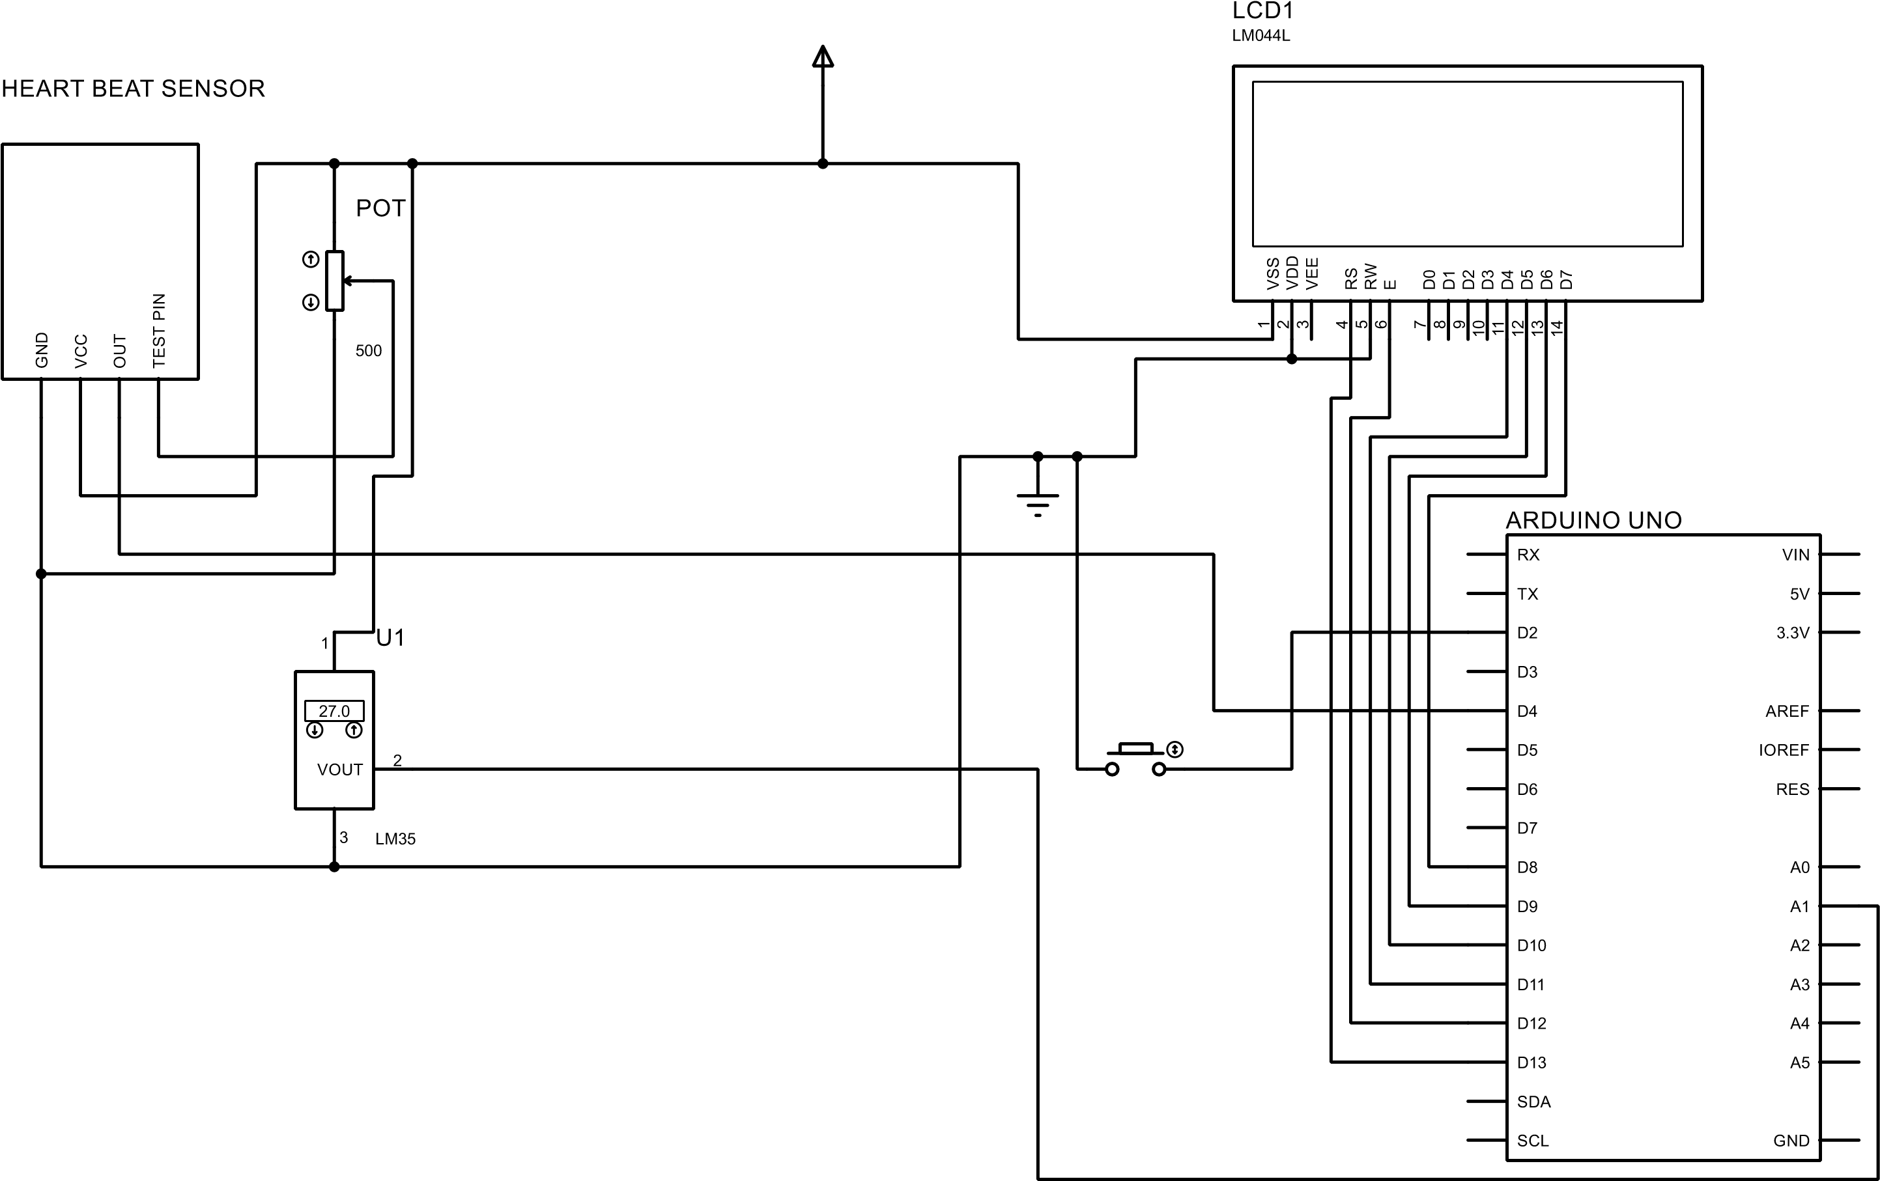
Schematic diagram

Slide 15
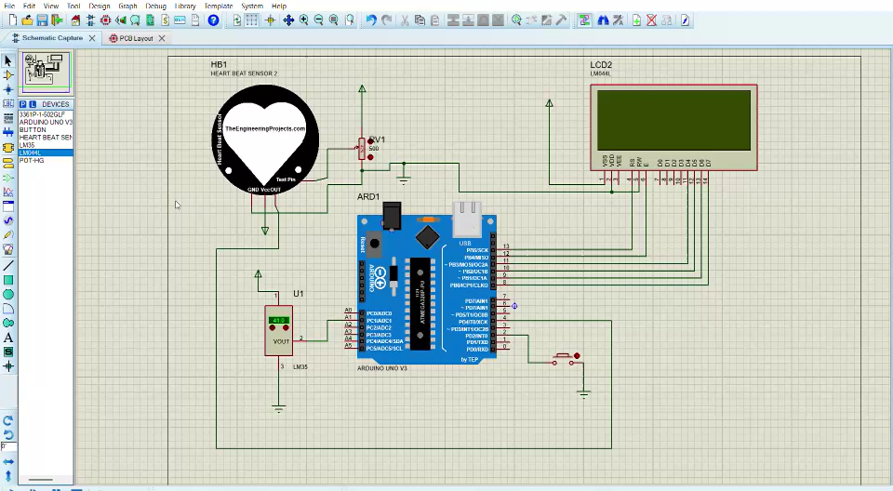
Demonstration/simulation

Slide 16
CHALLENGES & IMPROVEMENTS
Challenges:
•The simulation cannot accurately replicate the human heart waveform.
•The software lacks a built-in heart sensor, so we had to import it from an external source, which had its own limitations.
Improvement: Integrate a more advanced heart model or connect the simulation to real-time biometric data for better accuracy.

Slide 17
Some refrences
Reference: The Evolution of Vitals Monitoring: From Clinics to Smartphone Apps - Veyetals
Arduino Uno Library: https://www.theengineeringprojects.com/2023/11/arduino-uno-library-for-proteus-v30.html

Slide 18
Conclusion
In conclusion, sensor-based temperature and heart rate monitoring devices provide a quick, precise, and practical means of monitoring vital signs. These sensors were integrated with microcontrollers to gather and analyze health data in real time, enhancing remote patient monitoring and personal healthcare. This technology marks a significant step toward more efficient and accessible medical solutions.

Slide 19

Thank you!

